Slide 1
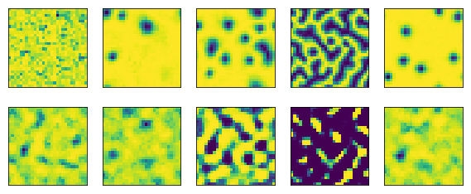
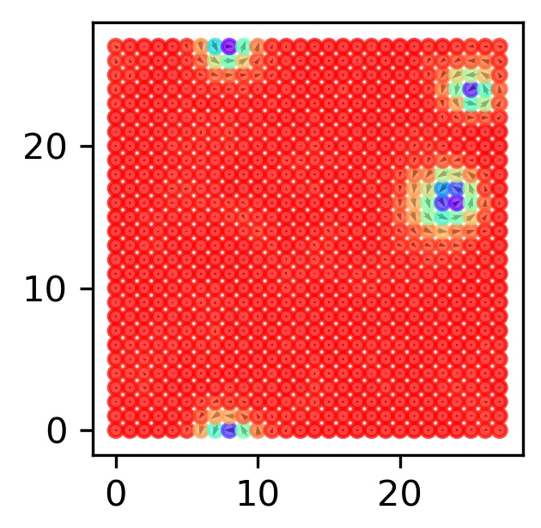
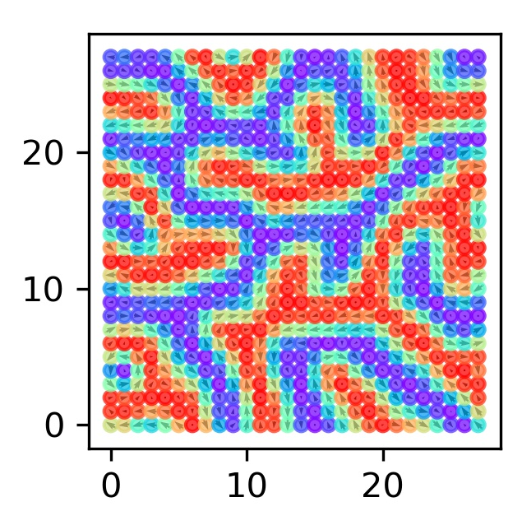
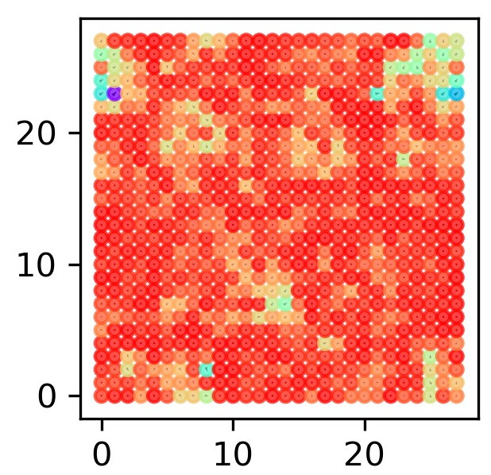
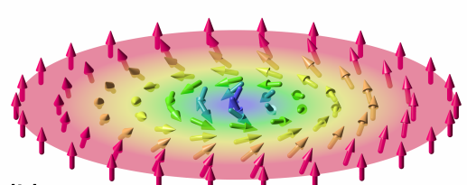
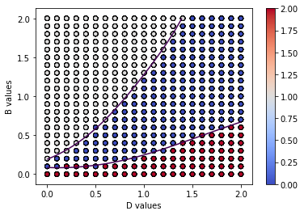
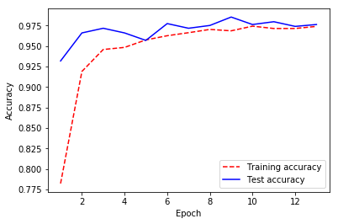
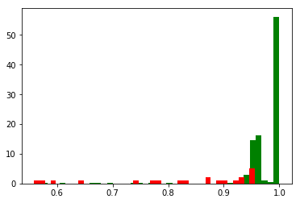
Supervised Learning for Classification of Magnetic Phases Jason Guo
INTRODUCTION
Solid state systems that have certain interaction between atoms' spins, under different conditions, will have different magnetic phases.
METHODS
Monte Carlo Simulations of Magnetic Phases
We start with a system of 28x28 randomly oriented spins. Then we randomly choose one of those spins and reorient it along a new random direction. If the new energy is lower than the previous energy, , the change is accepted; otherwise, the probability of acceptance is . During each iteration, this process is repeated for 1024 times.
METHODS
Support Vector Machines for phase boundaries decisions.
Phases are generated under D between 0.0~2.0 and B between 0.0~2.0. The phases are classified by the multiheaded convolutional neural network. Two sklearn non-linear SVMs with 'rbf' kernels are employed to draw the lines between ferromagnetic phases, spin spirals and skyrmion phases.
Phase Diagram
Finally, a phase diagram, where D and B range between 0.0 and 2.0, is generated. There are 7056 phases in total. Each phase point is labeld using the multiheaded network. To avoid the error due to the network, only data points where the probability is greater than 0.9 are used.
The phase diagram has 2977 skyrmions, 1028 spin sprials and 2575 ferromagnetic phases.
Two non-linear SVMs are trained for classification. One for Skyrmions and ferromagnetic phases and the other foor Skyrmiions and spin spiral phases.
The decision functions are decided across the phase diagram. The contours of decision function value equal to 0 are plotted for both of the models.
CONCLUSIONS
A plausible simulation of magnetic phases under different conditions is achieved. The model is able to reflect the change of phase under different DMI strength and external magnetic fields.
The variational autoencoder method is not good at classifying the phases. The guess is that a latent dimension of 100 is not enough for the 28x28 model. As can be seen in the figure, the reconstructed patterns do not match the original patterns faithfully. In addition, the VAE methods require a large amount of parameters.
In contrast, the multiheaded network shows superior performance in the terms of accuracy, while requiring way less parameters.
Finally, a phase diagram is generated and clear boundaries between phases can be seen and fitted. As the magnetic field increases, the spin spirals break down and shrink into isolated skyrmions. At high fields, the spins are saturated and form ferromagnetic phases.
The Hamiltonian of the system is typically^{[1]}:
Examples of reconstruction of input z spin images by the convolutional VAE network
The first term is the Heisenberg exchange, which pulls all spins into the same direction when J>0. The second term is the Dzyaloshinskii–Moriya interaction, which, in contrast, favors spins pointing in different directions. The last term is the Zeeman energy term bending all spins towards the external magnetic field.
The reconstruction results are not as good as expected and the subsequent encioder-classifier stacked network only has a validation accuracy of 0.9397(for VAE) and 0.9135(for convolutional VAE).
For finite temperatures, after enough times of iterations, the spins will tend to stabilize.
For reproducibility, four same simulations are run at each D and B combination.
Meanwhile, the multiheaded convolutional neural network has a much better performance, yielding a best validation accuray of 0.9852, while requiring only 58,303 parameters.
In general, typical phases are ferromagnets, spin spirals, skyrmions and paramagnetic phases.
Ferromagnetic
Skyrmion
Simulated Skyrmion phase
Simulated spin spiral phase
Simulated ferromagnetic phase
The multiheaded validation accuray during the training process.
Schematic of a typical Skyrmion
https://en.wikipedia.org/wiki/Magnetic_skyrmion
Multiheaded Convolutional Neural Network for Phase Classification.
The images of different phases all consist of 28x28 z spins values. The average z spin values are also calculated.
To discover patterns at different scales, the network has 3 input layers connected to 3 convolutional layers with different kernel sizes: 5, 9 and 13.
The outputs of layers are merged and combined with the average z spin values and then fed to a fully connected layer. Keras functional API is used for this purpose.
The network classifies the pre-shuffled dataset into ferromagnetic phase(1), spin spirals(2) and Skyrmions(0).
RESULTS
Classification
Before the multiheaded convoutional neural network was finally adopted, (convolutional) variational autoencoder(VAE) was tested. The initial goal was to identify the proximity of different phases in the latent dimension of 100.
The VAE network here has 708,784 parameters in total, and the stacked network has 9,859 trainable parameters. The convolutional VAE network has 3,240,184 parameters and the stacked network has 6,659 trainable parameters.
However, the performance of the VAE and convolutional VAE are not satisfying.
AIM
The goal is to use Monte Carlo simulation that directly evaluates the Hamiltonian of system to predict the stochastic behavior of a 2D array of atoms.
By tuning the interaction strength D and B, different magnetic phases are acquired and used to train a classifier.
Finally, this classifier is used to classify the phases in a phase diagram, and a support vector machine is employed to plot the boundary.
References and Resources
I. A. Iakovlev, O. M. Sotnikov, and V. V. Mazurenko, Supervised learning approach for recognizing magnetic skyrmion phases, Phys. Rev. B 98, 174411
ZHOU, YIFAN (2016) Computational Modeling of the Phase Diagram of Magnetic Skyrmions. MSc by research thesis, University of York.
The computational resources are the courtesy of Ohio Supercomputer Center.
All codes are written using the Python programming language. The convolutional neural networks are constructed using Keras functional API. The VAE methods are adpated from Prod. Hughes' in-class materials. The non-linear support vector machine model is from sklearn package.
The histogram of the multiheaded network's true(green) and false(red) predictions on the test dataset.
Spin spiral
The phase diagram and contours of the decision function
As can be seen, the phase diagram has an obvious pattern of the phase distribution and the two purple contours well seperates the different phases.
https://github.com/big-data-analytics-physics/bigdata_6820-JasonGuo0/tree/master/finalProject

